Slide 1







Return to Work Assistance
Keeping people and companies safe.

Slide 2
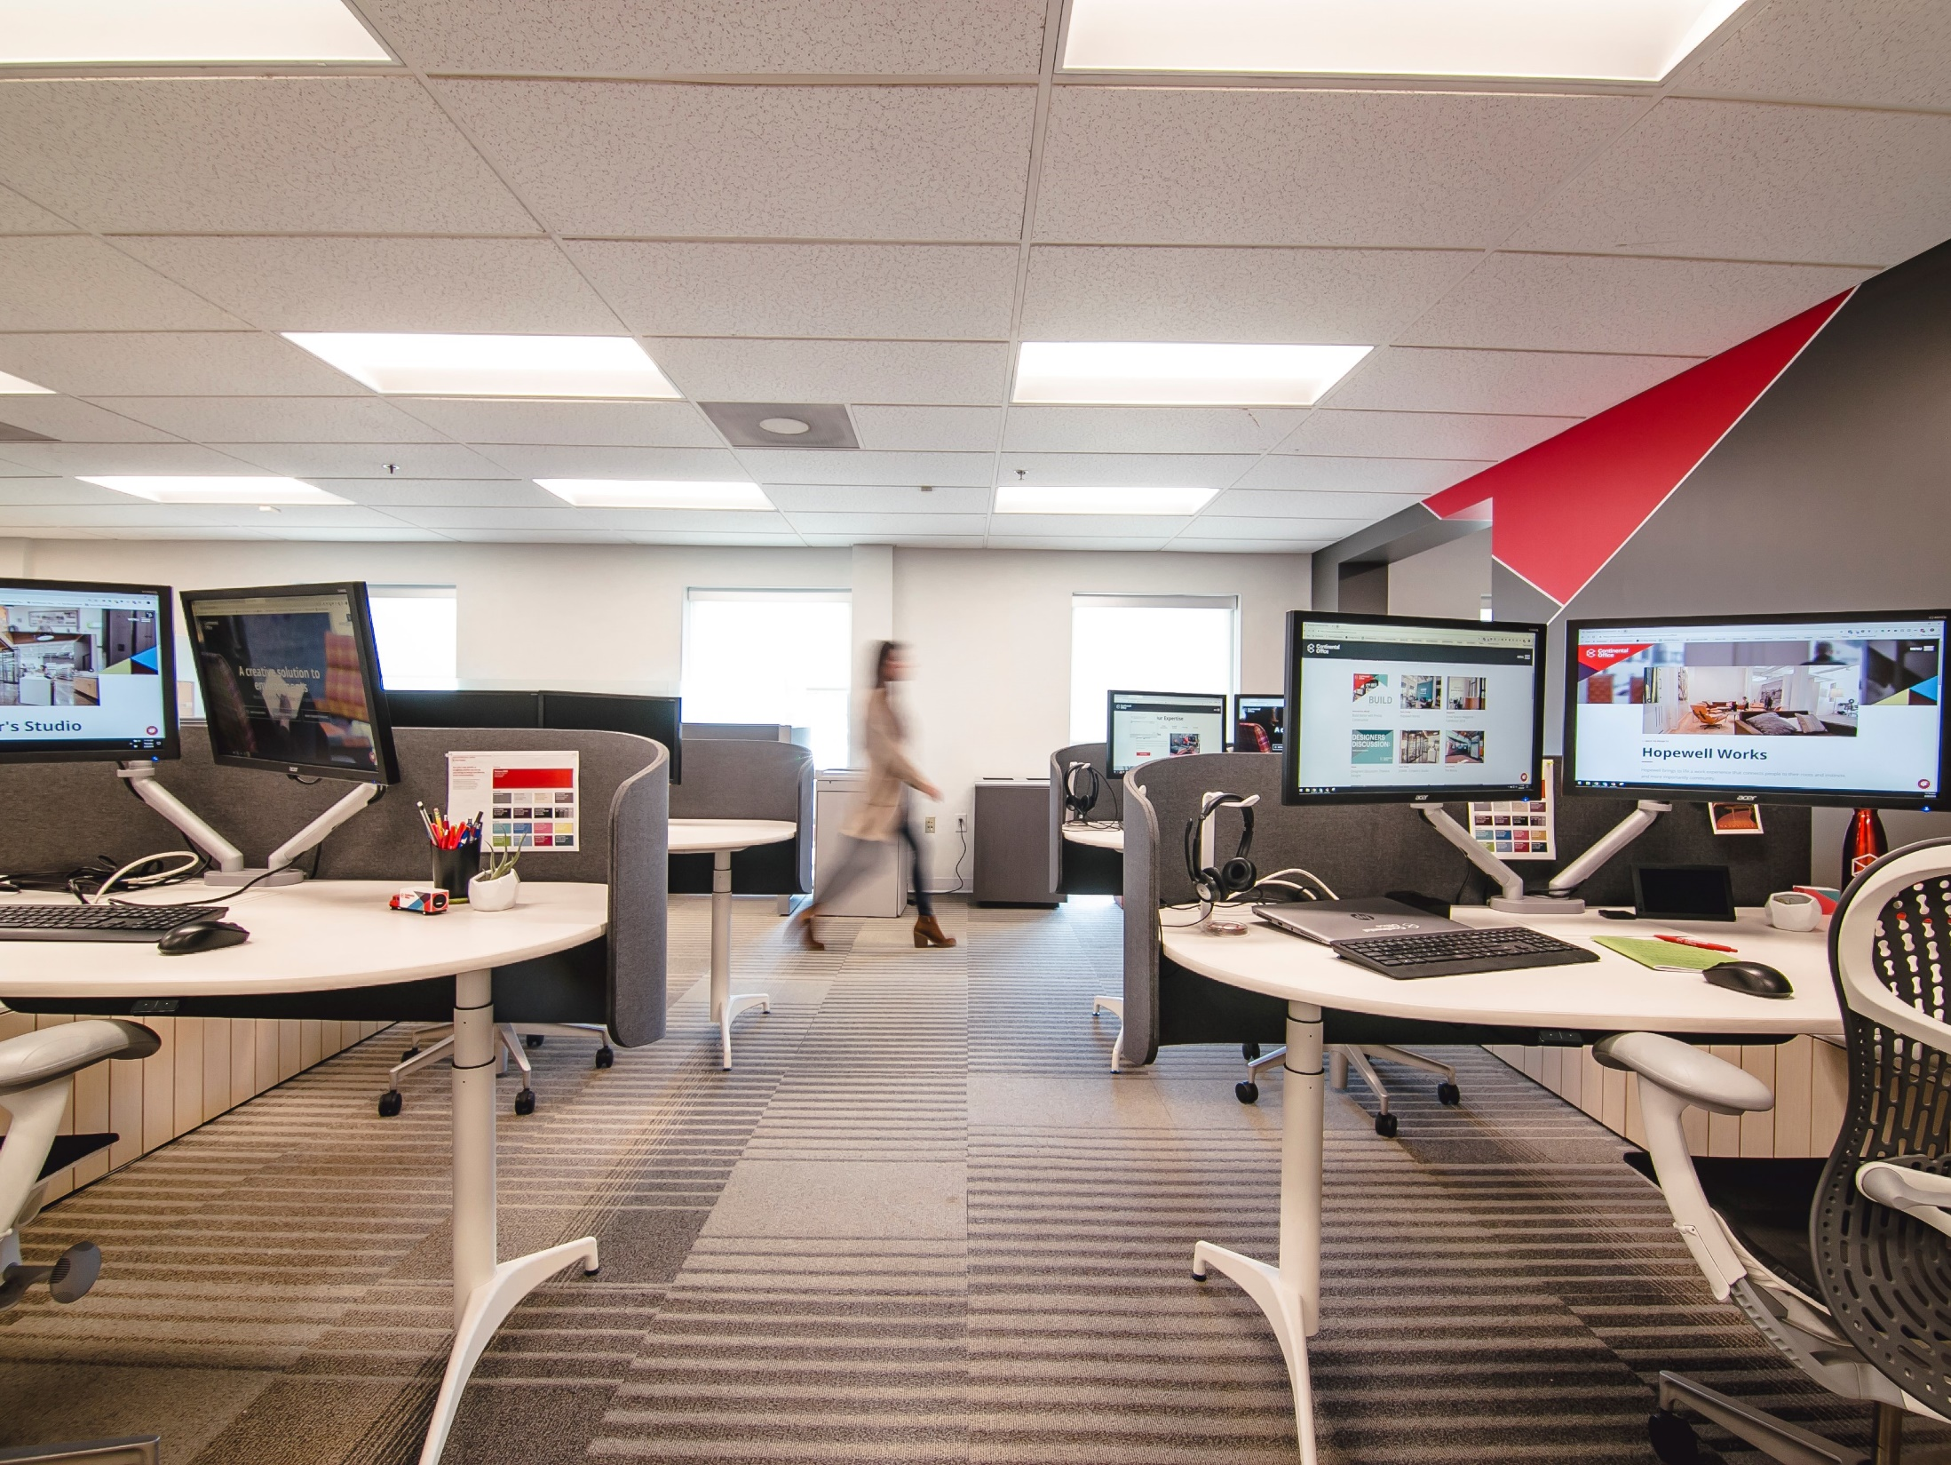
There are many factors that need to be considered as we all develop our Return to Work (RTW) plans.
Our objective is to provide as much insight and support as possible to our clients.
The information that follows is not meant to be an all-inclusive guide, but rather ideas and insights.
There are specific areas where we have deep expertise and can provide products and/or services for RTW programs.
Overview
Notes:
We’re here to support our clients and partners like you.
We’ve been doing this for a long time so we’re prepared to help in a variety of areas that we have specific expertise

Slide 3





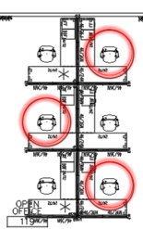


You’re already…
Communicating
Changes
Cleaning
Guidelines
Virtual Training
Getting PPE
Phasing People Back In
Assessing Layouts
Visitor Guidelines
Notes:
We’re all currently developing our plans. Everyone is doing the following and more:
Developing new procedures and protocols (handbooks)
Conducting virtual training sessions prior to RTW
Communicating changes throughout the office
Cleaning & disinfecting the entire office
Purchasing appropriate PPP for their people
Reaching out to various partners for guidance
Deciding on how to phase people back in….mostly office, flexible, continued WFH
Assessing existing layouts/designs to accommodate physical distancing (workstations, private spaces, open areas, cafes, etc.)
Considering adding new safety related products or removing existing products
Figuring out how to effectively handle visitors and customers

Slide 4
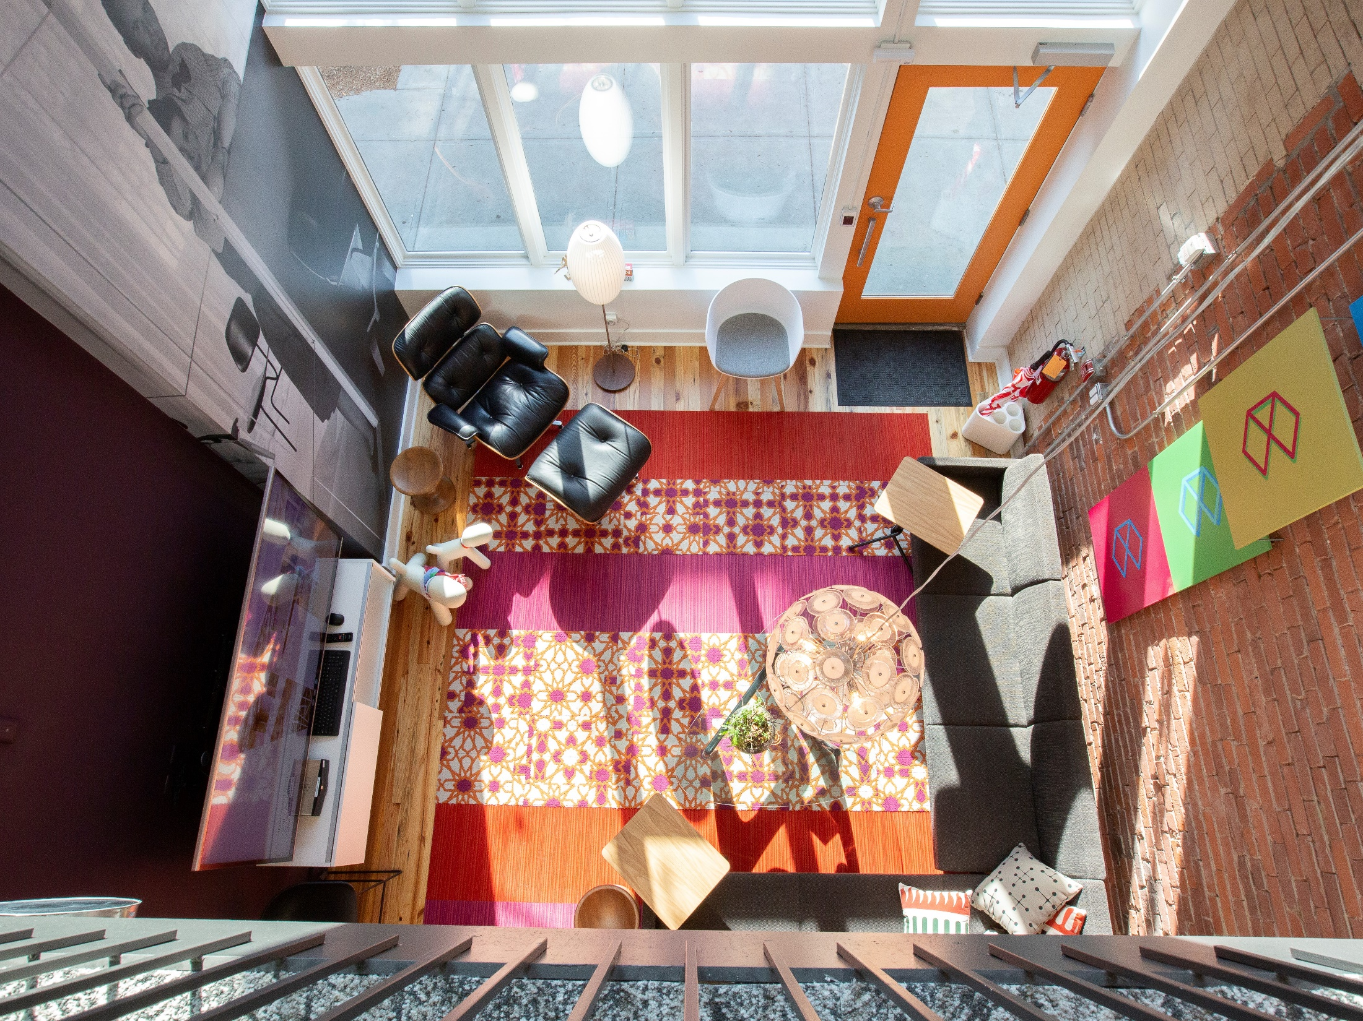
You’re asking…
Are we ready to return to the office?
How do we ensure the office is safe... Day 1 and beyond?
Do we return to how things were before?
What have we learned from WFH?
What technologies will be required?
What are our associates most concerned about?
Will we need new products and/or solutions?
How can we best serve our customers’ needs?
Notes:
IN addition to what we’re all doing, there are questions we should be asking ourselves like the following:

Slide 5

What we know…
<
Companies like yours are figuring out how employees safely return to work:
Day 1, Near-Term, & Long-Term
Key topics include:
proper safety & cleaning methods
open areas, conference rooms, workstations
new products to support 6’ distancing
communicating changes and safety signage
Current planning includes phased approaches & continued WFH
New workplace guidelines will continue to evolve
<
<
<
People want to know they’ll be safe in the office
Notes:
Here’s where we come in and can help.
We have a lot of knowledge we can apply to your plan.
We know…

Slide 6

How we’re adapting…
Our Return to Work Action Plan:
Disinfected our work areas and deep cleaned all locations
Increased cleaning and disinfecting protocols
Implemented associate identification plan & work procedures
Building access protocols
Evaluating and reconfiguring our work areas
Providing technology to WFH
Providing PPE
Enforcing CDC social distancing guidelines
Implementing a visitor best practices process
Developed a COVID-19 protocol should someone test positive
Notes:
At CO we’re taking that knowledge and putting it into action.
Here’s what we’re doing and we can do the same for you

Slide 7

What we’re doing…
<
Created a survey to understand people’s experience with WFH, identify concerns they have upon returning to the workplace and gain insight into future company plans (420+ responses!)
Developed scenarios for Continental Office work spaces to meet government requirements and ensure physical distancing
Based on our own research and numerous discussions with clients and CRE leaders, drafted a procedure and protocol handbook
<
<
Notes:
We’re also staying on top of the RTW evolutions by conducting our own surveys, implementing best practices in our space, and conducted our own research to stay on top of what leaders, like yourselves, are doing.
We’re also forming strategic partnerships with companies like Aunt Flow to continually supply our teams and visitors with PPE.

Slide 8
What we found*…
1. Ongoing Disinfecting & Regular Cleaning is Paramount
95% of today’s workforce expects the workplace to be fully disinfected prior to returning.
96% want increased cleaning and disinfecting protocols on a regular basis
90% of workers want to know what their company’s cleaning process
2. Reconfiguring Space for Physical Distancing is a Reality
71% of people want dividers and partitions for open workstations
89% think we need to limit the number of people in common areas
76% of people think we should eliminate shared seating.
58% of C-Level Leaders are planning to redesign their workplace
(33% are undecided)
3. Accepting Part-Time Remote/WFH is the New Normal
67% of C-Level said COVID-19 changed their perception of working from home and are planning to have some/all work from home now
74% of people ages 25-44 want WFH options as compared to 53% of those ages 45-64.
*Source: May 2020 Continental Office RTW Survey
Notes:
What we’ve found so far:

Slide 9

What we found*…
4. People Can Be Productive While Working From Home
30% of people feel more productive & 42% feel they are just as productive
59% cited less distractions and 53% credit a flexible schedule
73% would like a better home office set-up (ergonomic chair, etc.)
5. People Still Want a Physical Workplace Environment
94% still want a physical workplace to work within at times
Only 12% want to work in the office 100% of the time
63% want a mix of working in the office and remote
19% want a mix of the office, at home, and a co-working space
6. Without a Physical Workplace People Miss:
22% miss the ability to use meeting rooms and other private spaces
46% feel less connected to their team when 100% remote
49% miss visiting with customers
72% miss the social aspect of being with co-workers
*Source: May 2020 Continental Office RTW Survey
Notes:
What we’ve found so far:

Slide 10
How we can help you…
CLEANING
& DISINFECTING
PHYSICAL DISTANCING (6 FEET)
• Deep clean of floors, furniture, and surfaces
• Disinfect entire work areas
• On-going scheduled service
• Assess existing designs / layouts to identify any gaps
• Reconfigure workstations
• Provide temporary storage
SAFETY SIGNAGE/
COMMUNICATION
SAFETY
& WFH PRODUCTS
• Screens, panels, dividers, etc.
• WFH products (height adjustable tables, task chairs, monitor arms)
• PPE (face masks and hand sanitizer)
• Wayfinding and other graphics to communicate new protocols and procedures
<
We use our own associates to perform these services
Notes:
*I wouldn’t include Aunt Flow here, as you mentioned in an earlier slide.
We can help you with four strategic areas of your plan:

Slide 11
How to get started…
Initial meeting to understand your current RTW plans and identify any gaps
Review existing layouts and create design modifications as needed
Develop product options to meet company safety protocols (if needed)
Provide WFH product options if requested
Review recommended solutions and estimated costs
Notes:
Since you’re ready to get started, here’s how we can jump in immediately and help!

Slide 12
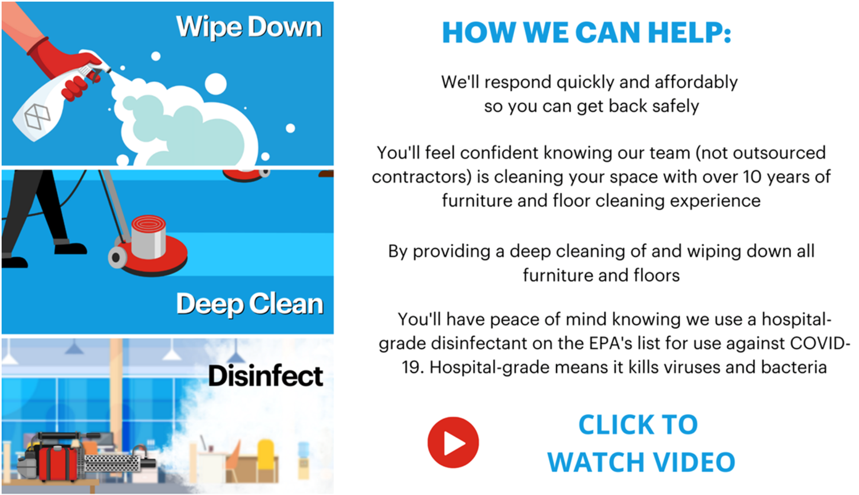
Cleaning & Disinfecting Services

Slide 13
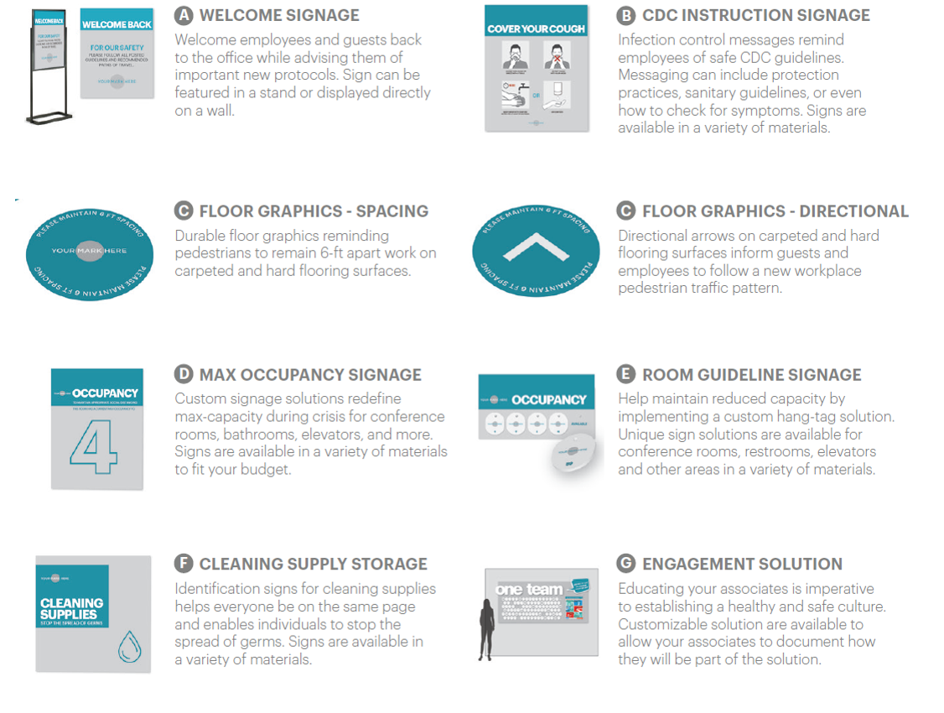
Safety Signage Overview
Notes:
Since you’re ready to get started, here’s how we can jump in immediately and help!

Slide 14
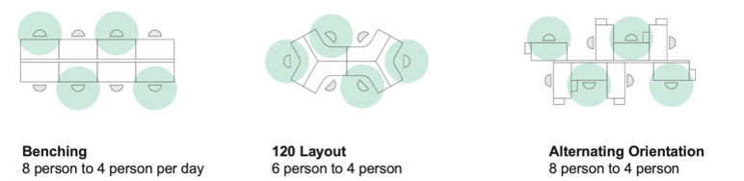
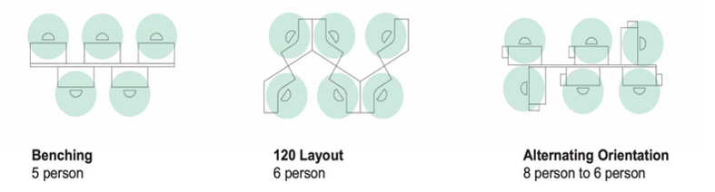
Physical Distancing Seating & Workstations
Staggered Desk Assignment:
Alternating days | No desk sharing | Less density per desk
Dedicated Desk Assignment:
Furniture adjustments required | No desk sharing | Increased density per day

Slide 15
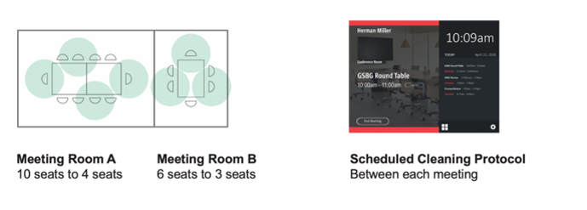
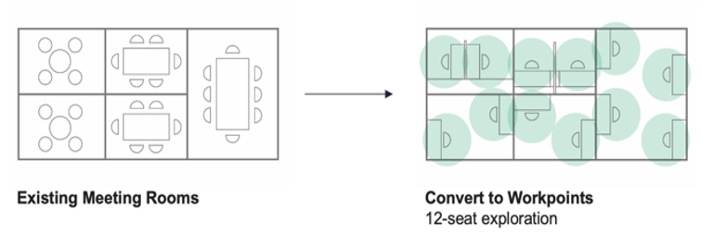
Physical Distancing Meeting Rooms
Reduce Occupancy of Enclosed Spaces:
No furniture changes| May require chair storage
Alternate Applications:
Furniture adjustments required | Increased floor density per day

Slide 16
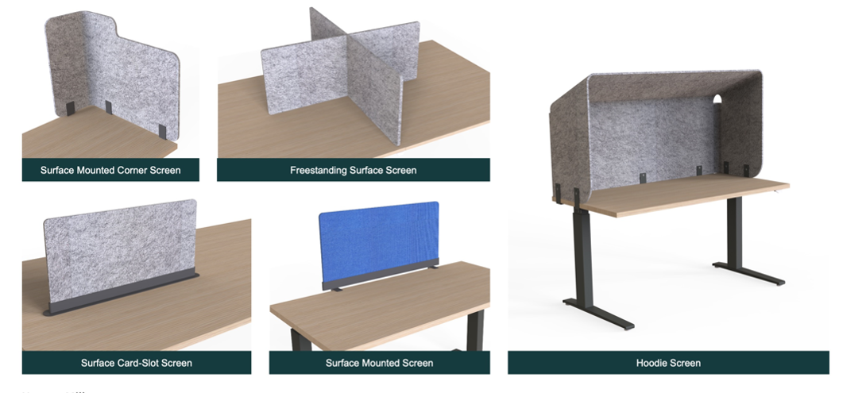
Safety: Worktop Screens
Visual cue that things have changed
Delineates workstation space and ownership
Quick to deploy and easily removable for flexibility

Slide 17
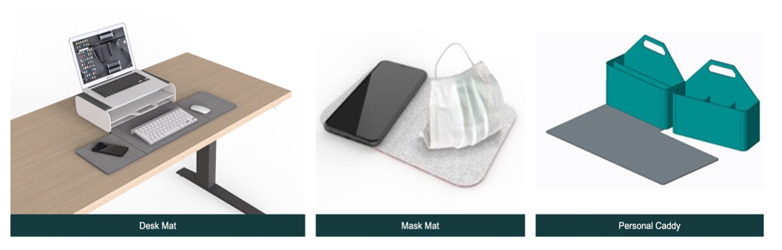
Safety: Personal Mobile Storage
Great for moving between home and office!
Reduce contact with common surfaces
Easy to move between workpoints
Take home personal items at the end of the day

